Slide 1
A Recap of Economic Theory, Markets, and Willingness to Pay
Prof. Parthum
Environmental Economics Econ 475

Slide 2
Demand and Supply
A “market” for “something”…
Demand for something slopes downward… why?
If something is more expensive, the quantity demanded will be less
substitution
income
decreasing marginal benefit
Supply of something slopes upward… why?
As a “supplier” produces more of something it becomes more expensive to supply one more unit of that something
i) increasing marginal costs

Slide 3
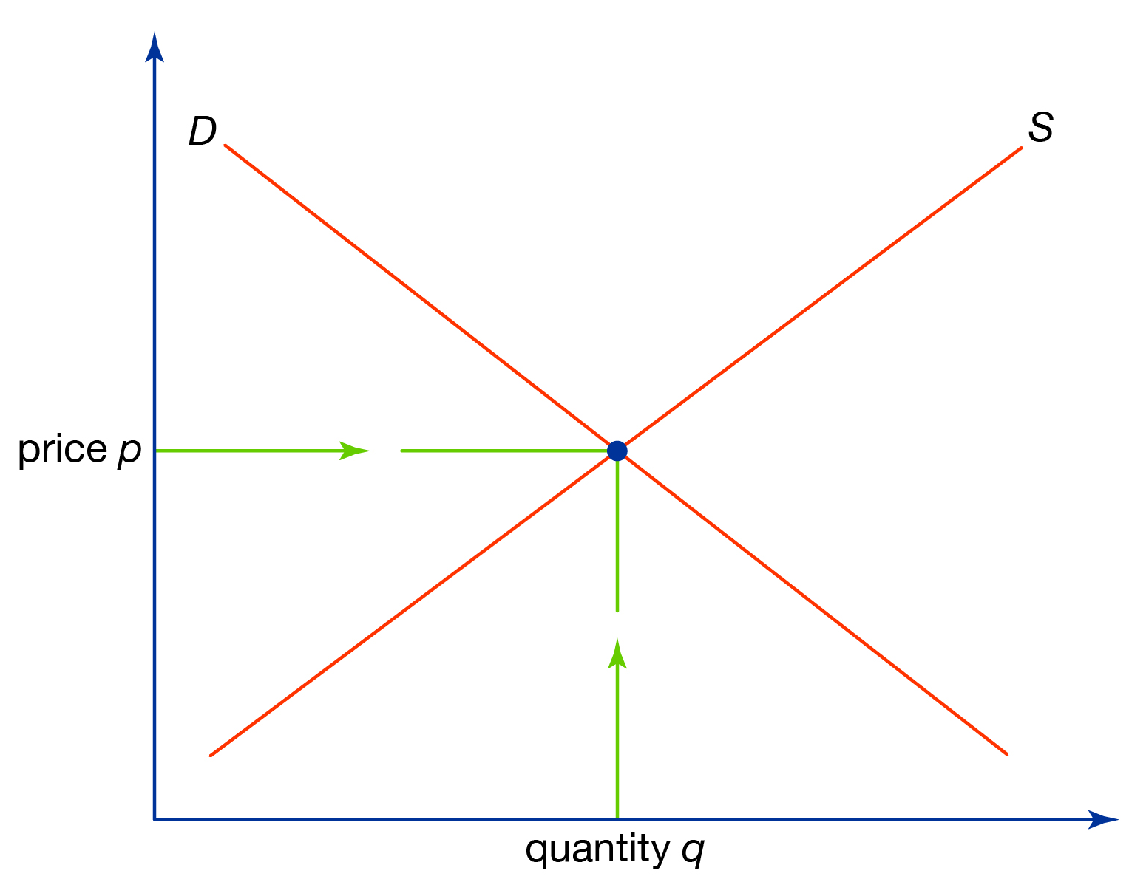
Demand and Supply
increasing marginal costs
decreasing marginal benefit

Slide 4
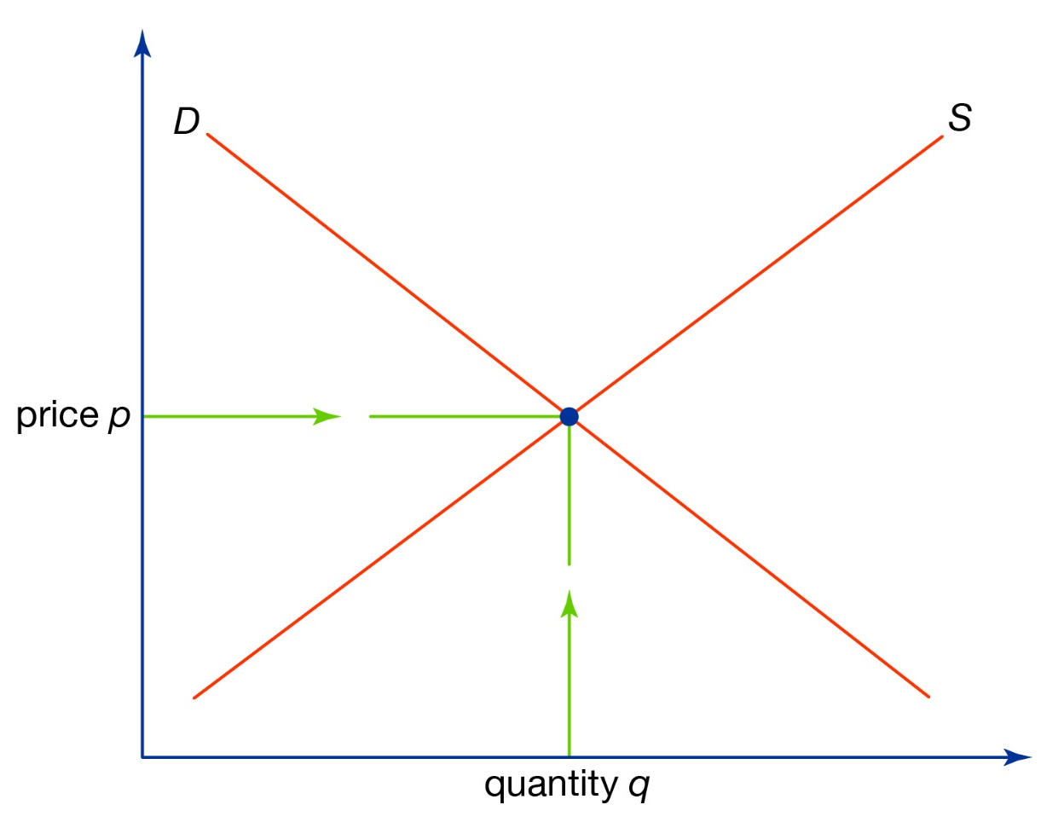

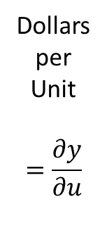
Demand
Total Benefits
Marginal Benefits
Dollars
per
Unit
$$=\frac{∂y}{∂u}$$
Dollars
= $Y$
Total
Benefit
Marginal
Benefit
Units
Units

Slide 5



Demand
Total Benefits
Marginal Benefits
Dollars
per
Unit
$$=\frac{∂y}{∂u}$$
Dollars
= $Y$
Total
Benefit
Slope of total
benefits line
$$y^{1}$$
Marginal
Benefit
$$u^{1}$$
Units
$$u^{1}$$
Units

Slide 6



Demand
Total Benefits
Marginal Benefits
Dollars
per
Unit
$$=\frac{∂y}{∂u}$$
Dollars
= $Y$
Total
Benefit
$$y^{2}$$
Slope of total
benefits line
Marginal
Benefit
$$u^{2}$$
Units
$$u^{2}$$
Units

Slide 7
Supply
Total Costs
Marginal Costs
Dollars
per
Unit
$$=\frac{∂y}{∂u}$$
Dollars
= $Y$
Marginal
Costs
Total
Costs
Units
Units

Slide 8

Supply
Total Costs
Marginal Costs
Dollars
per
Unit
$$=\frac{∂y}{∂u}$$
Dollars
= $Y$
Marginal
Costs
Slope of total
costs line
Total
Costs
$$y^{1}$$
$$u^{1}$$
$$u^{1}$$
Units
Units

Slide 9


Supply
Total Costs
Marginal Costs
Dollars
per
Unit
$$=\frac{∂y}{∂u}$$
Dollars
= $Y$
Marginal
Costs
Slope of total
costs line
Total
Costs
$$y^{2}$$
$$u^{2}$$
$$u^{2}$$
Units
Units

Slide 10

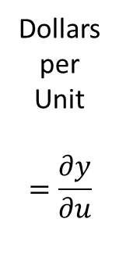
Demand and Supply
Total Benefits and Total Costs
Marginal Benefits and Marginal Costs
Total
Benefit
Dollars
per
Unit
$$=\frac{∂y}{∂u}$$
Marginal
Costs
Dollars
= $Y$
Total
Costs
Marginal
Benefit
Units
Units

Slide 11
Market for Pollution
Total Benefits and Total Costs
Marginal Benefits and Marginal Costs
Total
Benefit
Dollars
per
Unit
$$=\frac{∂y}{∂u}$$
Marginal
Costs
Dollars
= $Y$
Total
Costs
Marginal
Benefit
Units of pollution abatement
Units of pollution abatement

Slide 12
Market for Pollution
Total Benefits and Total Costs
Marginal Benefits and Marginal Costs
Total
Benefit
Dollars
per
Unit
$$=\frac{∂y}{∂u}$$
Marginal
Costs
Dollars
= $Y$
Total
Costs
Marginal
Benefit
More pollution
Less pollution
Units of pollution abatement
Units of pollution abatement

Slide 13
Market for Pollution
Total Benefits and Total Costs
Marginal Benefits and Marginal Costs
Total
Benefit
Dollars
per
Unit
$$=\frac{∂y}{∂u}$$
Marginal
Costs
Dollars
= $Y$
Total
Costs
Marginal
Benefit
Units of pollution abatement
Units of pollution abatement

Slide 14
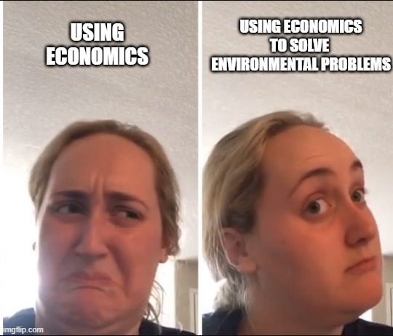
Market for Pollution
A “market” for “pollution”…
There are benefits from decreasing pollution
Benefits are decreasing in the
amount of pollution abatement
There are costs of decreasing pollution
Costs are increasing in the
amount of pollution abatement

